Slide 1


Pothole Detection
IoT Project

Slide 2


Team
Jash Gandhi
Shubham Patel
Rudram Vyas
Udith LN

Slide 3
Introduction
One of the many annoyances countless drivers face is the dreaded pothole. No matter how deep or shallow they are, driving over them is a huge pain and also are a major cause of axle and suspension failure in cars. While it seems that the prevention of pothole formation isn't getting any easier, we can record the location of the pothole and use this location to repair the pothole.

Slide 4
Problem Statement
About 1 in 10 drivers in the US have had to repair their car due to the damage caused by potholes. In 2021 the damage caused by potholes was approximately 26.5 Billion. Although thorough research has been conducted in this field, as of now there exists no app or software which keeps tracks of potholes on the road.

Slide 5
Related Work
While looking for related work we found a few previous attempts for similar applications. We found the data collected by them and tried to use it in our project as well.
We also used the project provided by the professor as a reference.

Slide 6
Proposed Solution
Through the means of this project we aim to create an app that can use the sensors present in our android smartphone, like accelerometer, gyroscope and magnetometer to gather data and use machine learning to detect potholes.

Slide 7
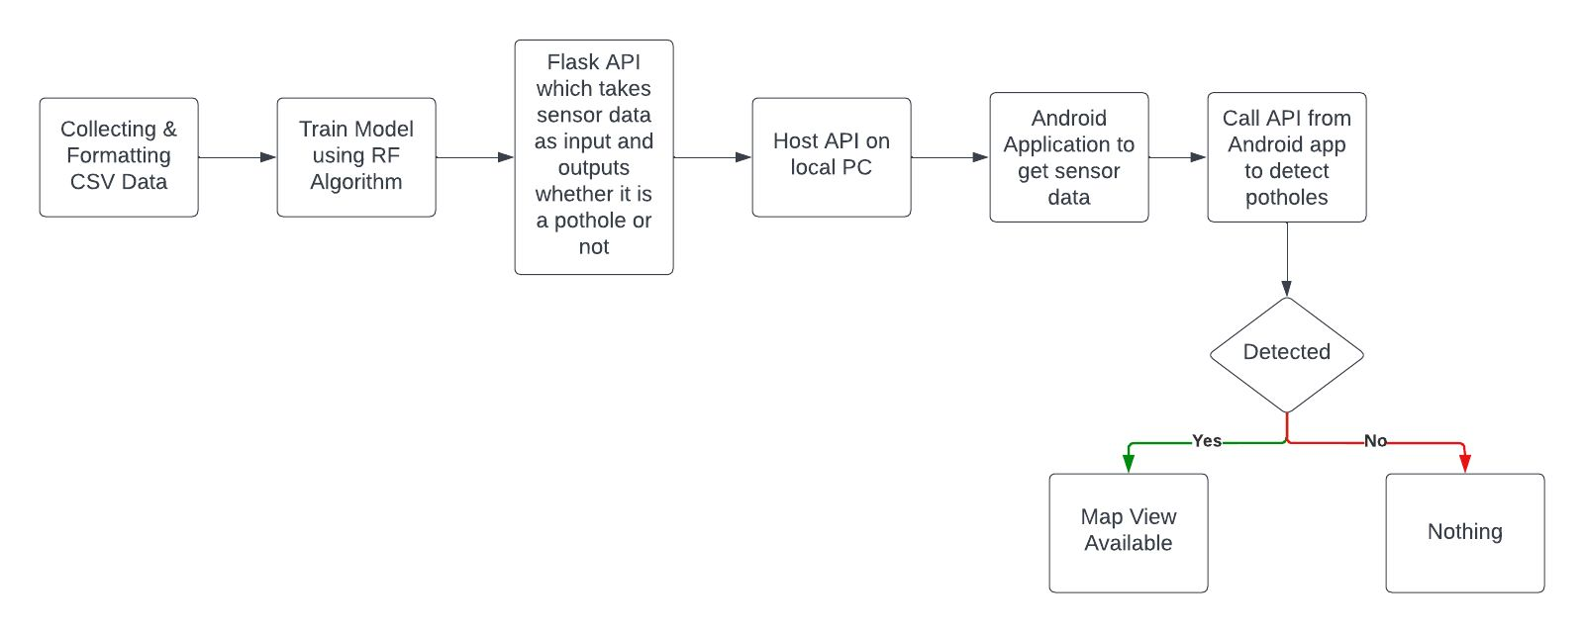
Flow Diagram

Slide 8
Experimental Evaluation

Slide 9
Data collection
To get the data to train the model, we searched for many similar projects available on open source platforms. We found different formatted data which we then converted to the format that was suitable for our specific model.
In the collected data we have the X, Y and Z axis sensor data for accelerometer, gyroscope and magnetometer.

Slide 10
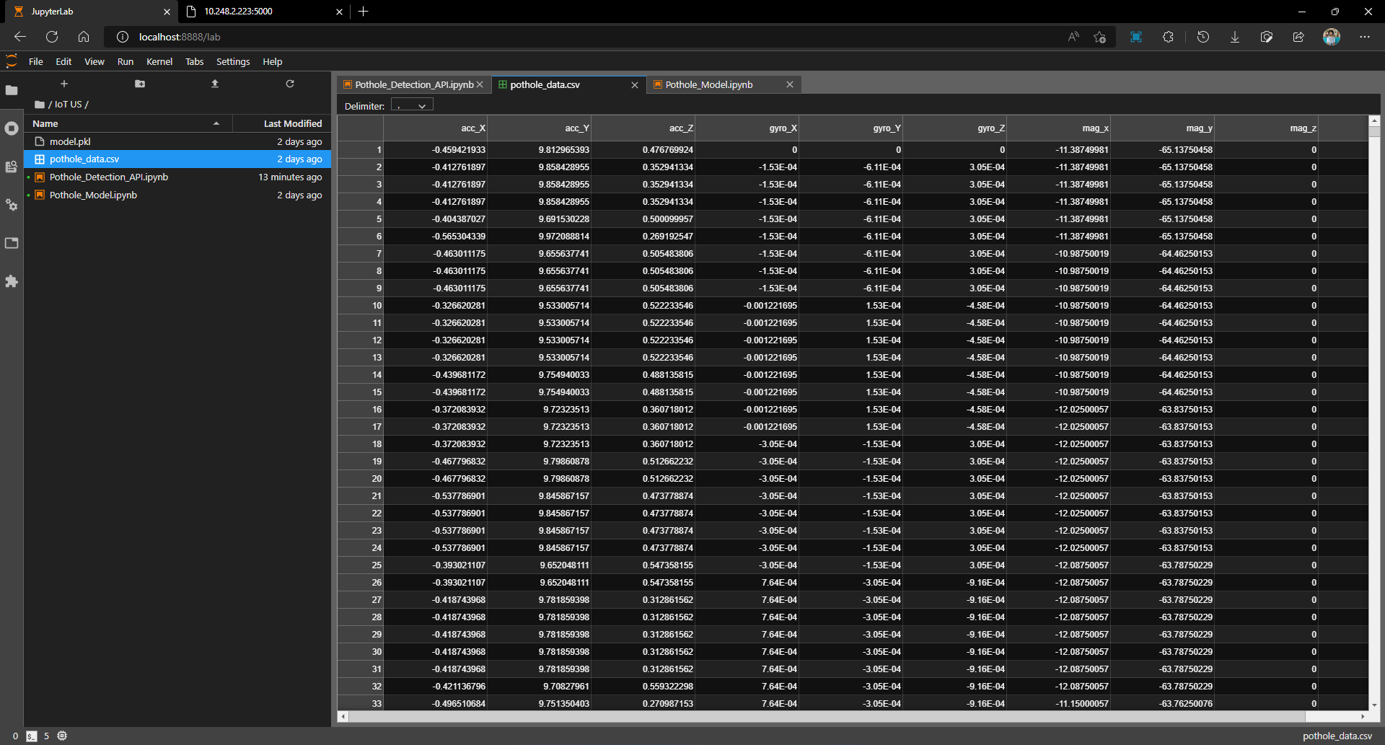
Data collection

Slide 11
Implementation
In the implementation phase, we tried to create multiple machine learing models to classify the different sensor data that we got.
First we created a model in python and exported in ONNX format so we can use the model in android.
In that approach we faced some fundamental difficulties while using the model in the android app.
So we settled on another model.

Slide 12
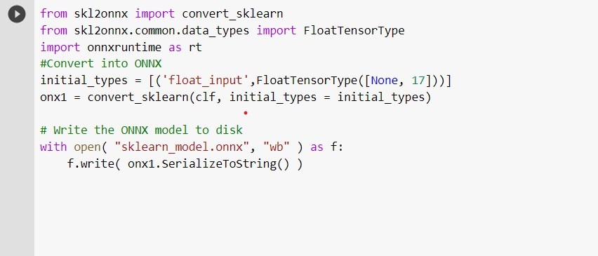
Implementation

Slide 13
Implementation
In this approach we created a machine learning model using random forest classification, in python and created an pkl(pickle) file.
We created and hosted an api using flask on the local server so that we can access the url using our android device.
We then use the api to classify the sensor data in pothole or not a pothole.
We then show the location of the pothole on the map in the smartphone.

Slide 14
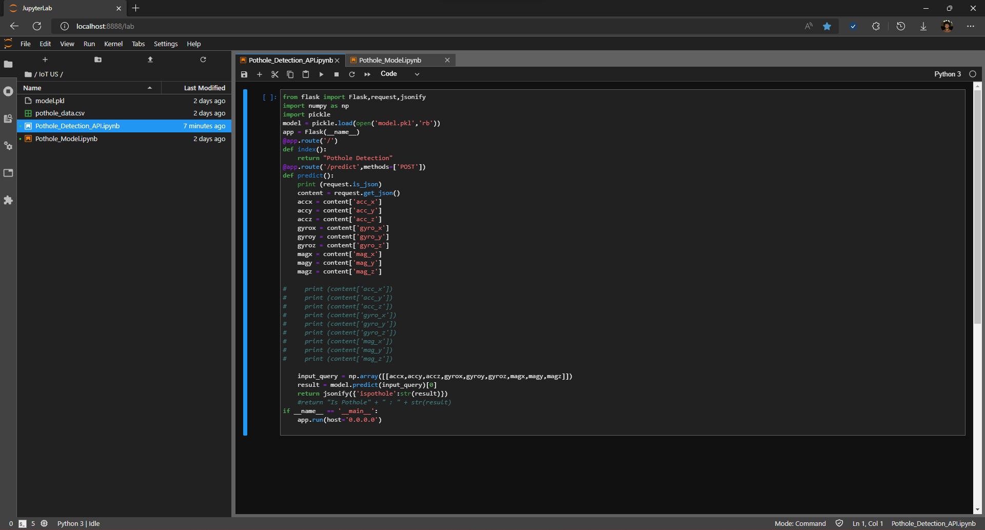
Screenshots

Slide 15
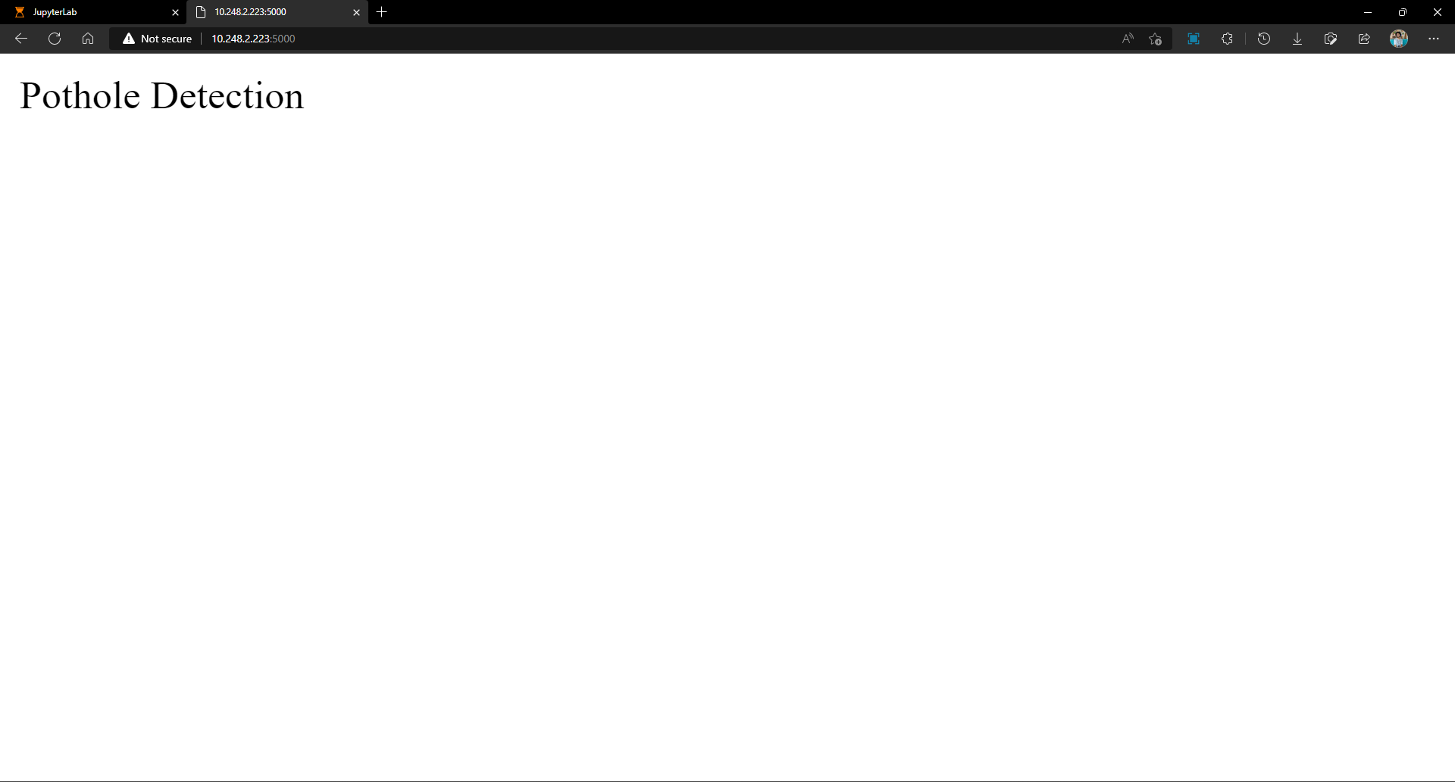
Screenshots

Slide 16
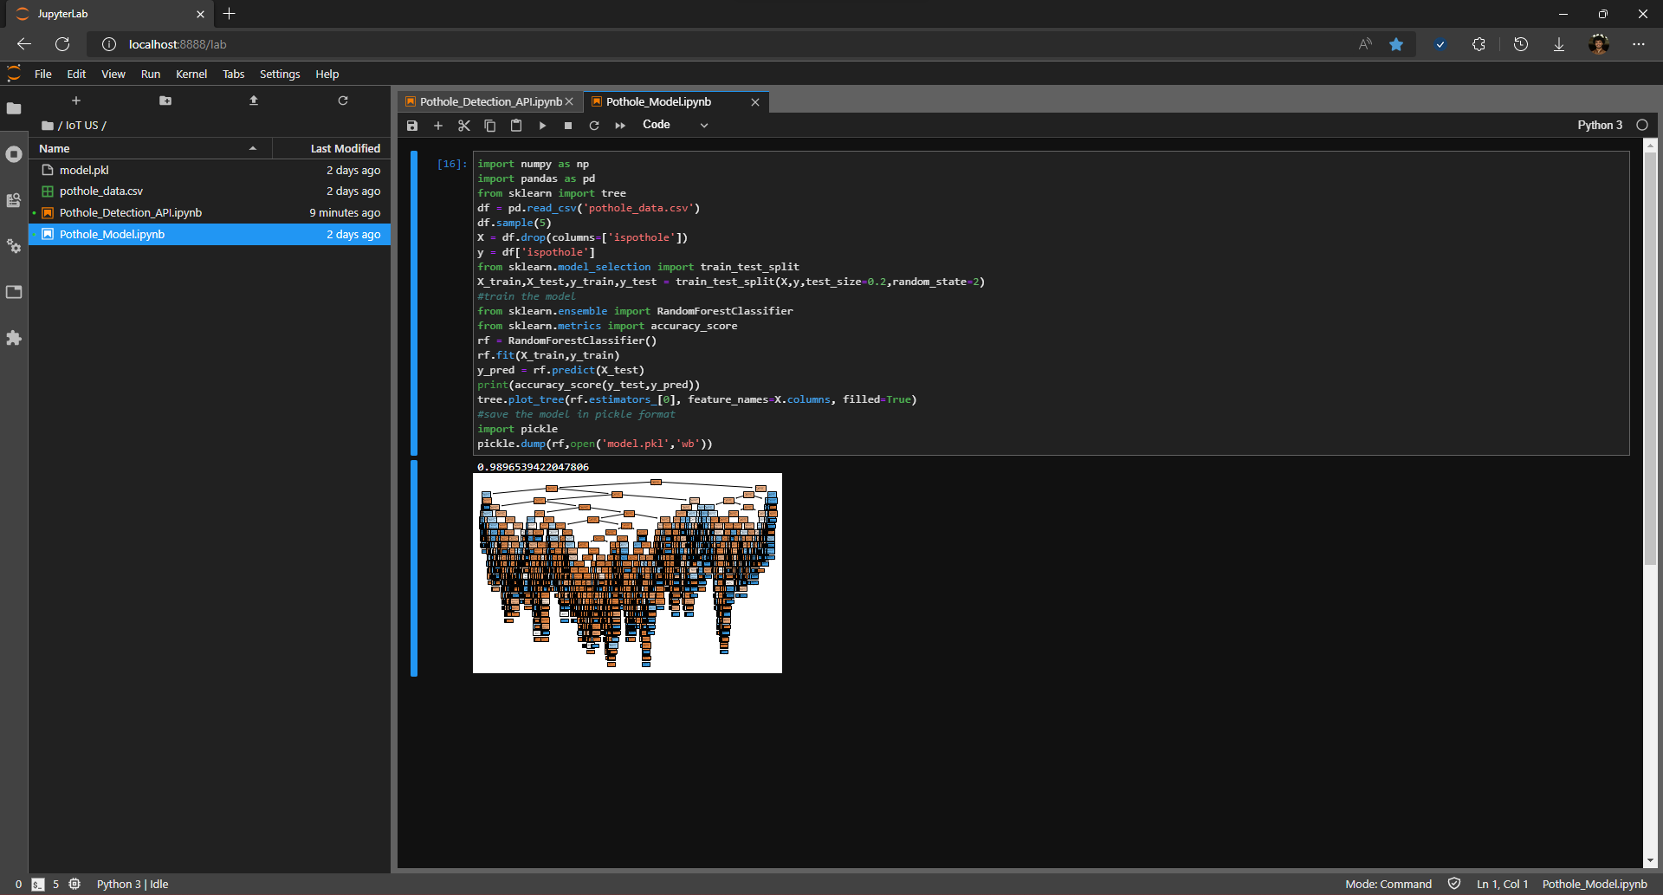
Screenshots

Slide 17
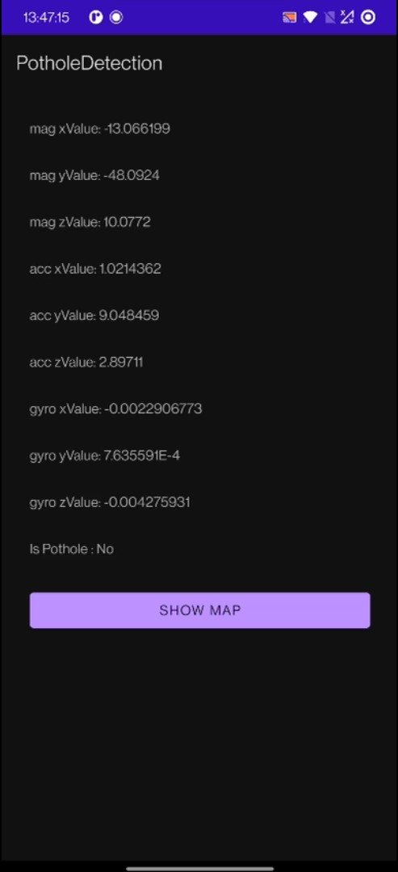
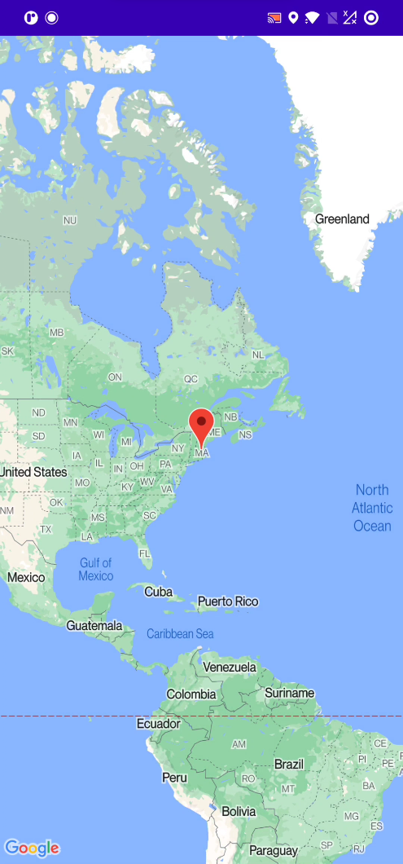
Screenshots

Slide 18
Frameworks Used
We used Python to create our machine learning model .
To create the application we used Android Studio.
We used flask to build and host the web API.

Slide 19
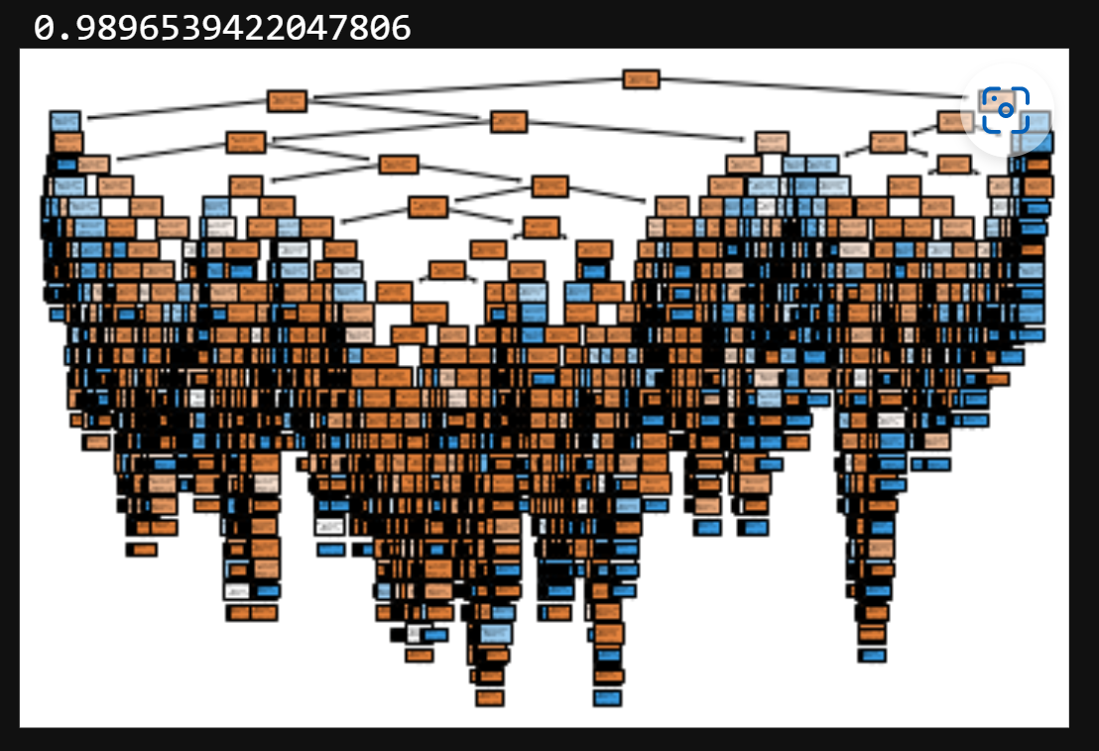
Algorithm
The machine learning model that we used here is Random Forest.
We got an accuracy of 98.96% using this model.

Slide 20

Demo

Slide 21
Results
As a result our app is successfully able to detect and classify any new input data as a “pothole” or “not a pothole”.
When a pothole appears, we can show the location of the pothole on the map by clicking a button.

Slide 22
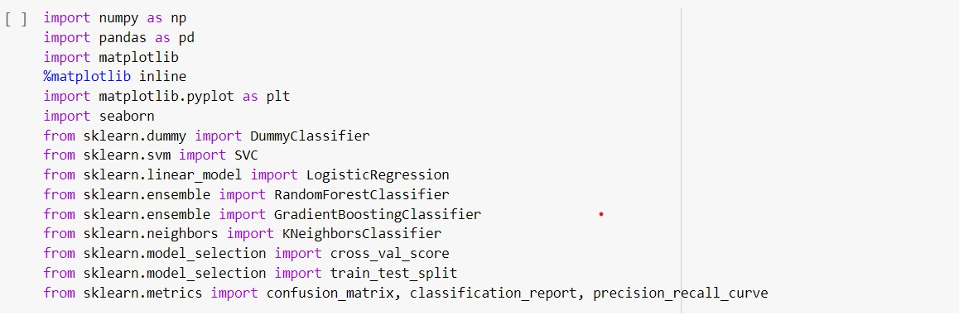
Screenshots
Other models we tried:

Slide 23
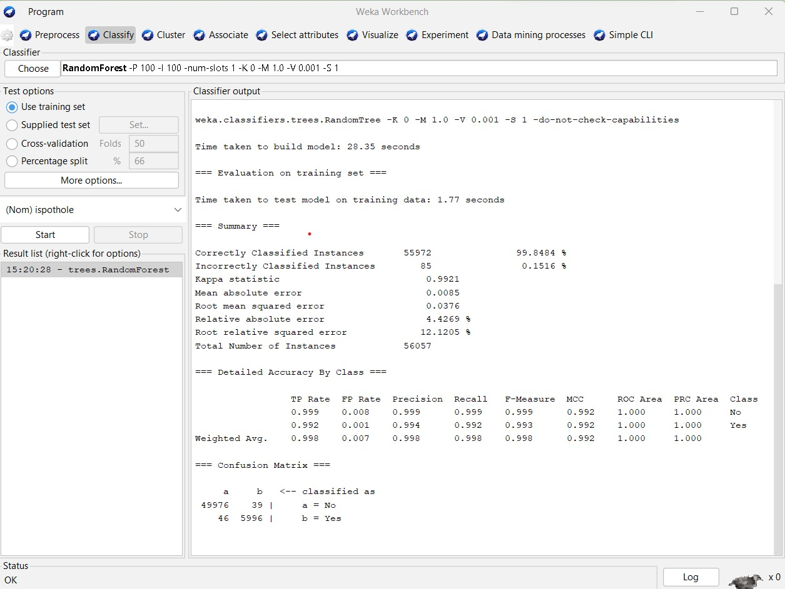
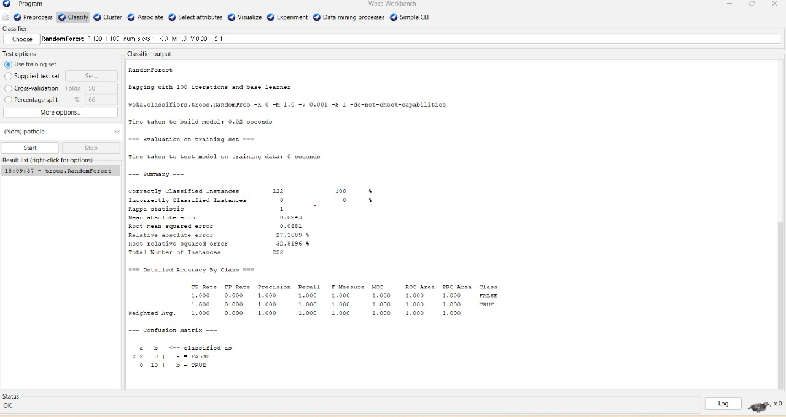
Screenshots

Slide 24
Conclusion
Using this app, we can help improve the current pothole situation and potentially prevent damages caused to cars because of potholes.

Slide 25
THANK
YOU!

